Slide 1
The
Royal Engineers Association
Annual Report
Annual General Meeting
7th Oct 2023

Slide 2
AGENDA
1 Presidents Introduction
2. To confirm the Minutes of the 54rd Annual General Meeting held on Saturday 8th October 2022
3. Matters arising from the Minutes of the 54th Annual General Meeting
4. To receive the Annual Report and Financial Statements for the REA for the period 1 January to 31 December 2022
Honorary Treasurers report
5. To note the appointment of Kreston Reeves LLP (formerly Reeves LLP), as the Auditors
of the Association
6. Appointment of Honorary Treasurer
7. REA Update
8. Benevolence Report
9. AOB
9. Date of Next Meeting

Slide 3
ITEM #1
Introduction

Slide 4
ITEM #2
To confirm the Minutes of the 54th Annual General Meeting held on Saturday 8th October 2022

Slide 5
ITEM #3
Matters arising from the Minutes of the 54th Annual General Meeting

Slide 6
ITEM #4
To receive the Annual Report and Financial Statements for the REA for the period 1 January to 31 December 2022

Slide 7
ITEM #5
To note the appointment of Kreston Reeves LLP (formerly Reeves LLP), as the Auditors
of the Association

Slide 8
ITEM #6
Appointment of Honorary Treasurer

Slide 9
ITEM #Appointment of Honorary Treasurer

Slide 10
ITEM 7
REA UPDATE

Slide 11
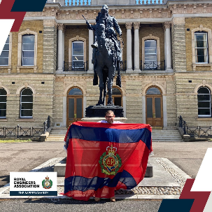
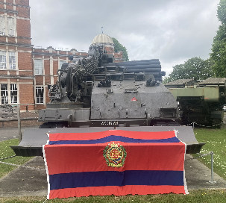
The Sapper Charity
REA has never fund raised before, why now?
Reduction in contributions to the Days Pay Scheme
Excuse to conduct meaningful activity whilst meetings the REA objectives (another option for Sappers to meet)
What and how will the REA fundraise?
Through individual(s) endeavors (marathons, cycle rides etc.) and planned events. There is no requirement for branches to “shake a tin”. Fund raising acitivity for “The Sapper Charity” is different to Fund raising activity for Branch funds. The two are distinctly separate activities.
How can HQ REA support my fundraising?
HQ REA can support through seed funding, branding and advertising.

Slide 12
Group Funds
Yordex cards have been introduced for all Group accounts, This is a pre-paid debit card. In 2024 Group accounts will move to the REA HQ Fund Manager who will provide the “banking Services”
Annual financial summaries can only be submitted online this year
We are again looking at the group structure as some of the groups are too small to be sustainable. Groups should have a minimum of 8 branches in order to be effective. What we have learned from the previous structure is that our current communication network with branches is not effective there is a significant disconnect between the actions of the various committees and this information feeding out to branches – which is why the development of the app is so critical.
REA HQ provision of banking services for groups and branches

Slide 13
REA Membership & Branches
Social Branches
Groups of Sappers who meet for whatever reason, they have a lead / admin who is a PoC.
No committee,
No vote at the AGM
No travel expenses
No property holding
No standard bearer
Proposed Membership changes:
All Arms Membership. Individuals belonging to another cap badge or service would be, on approval of a vote by branch membership, able to join their local REA branch. Branch Membership must not exceed 40% All Arms members.
Widowers & Widowers. Widowers and widowers of serving and former Sappers are offered free membership of the REA.
Associate membership. Approval of associate members delegated
to Branches (by a vote).

Slide 14
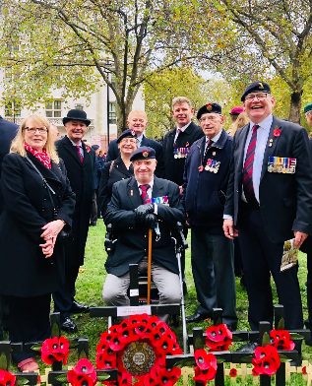
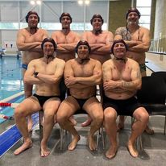
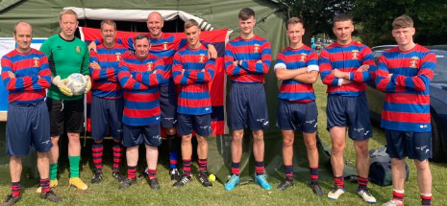
REA ACTIVITY
OCT 22 – SEP 23
Events
Field of Remembrance – Westminister
Wimbish Station Sports Facility
Op TELIC & HERRICK Memorial Rededication
Rededication Parade Truro Cathedral
New Corps flag raised at the NMA
Cpl Andrew George Mcilvenny Memorial
Corps Memorial Weekend
Sapper Com launched
Sapper Games
Fundraising launched
Business as Usual
Benevolence Committee Meetings x 4 (6 x out of committee meetings)
Management Committee Meetings x 2
Recruitment Committee Meetings x 2
Finance Committee Meeting x 1
Outreach
Unit and Branch Support Grants

Slide 15
REA ACTIVITY
OCT 23 – SEP 24
Events Oct 23 – Oct 24
Chillwell Winter Ball Nov 24
London Bridge Refurbishment, Normandy Apr 24
Monte Cassino, 80th Anniversary May 24
Gibraltar, Weekend 24 – 26th May 24
Ripon Weekend & Standard bearer gathering 8-9 Jun 24
Sapper Games Kinloss ## Jun 24
Ijzendijke, 80th Anniversary Oct 24
Sapper Weekend? Tbc
Areas of focus Oct 23 – Oct 24
Use of Sapper Com between branches and HQ to advertise events
Allow booking for events sooner

Slide 16
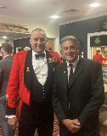
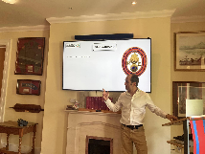
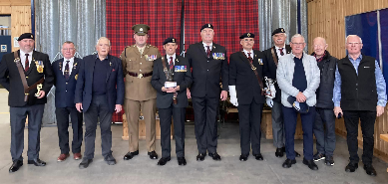
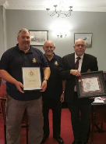
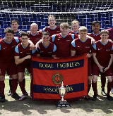
OUTREACH
Eastbourne Branch Meeting - April 23
RSM & SSMs Course Brief May - 23
Bath and West Wiltshire Sring Lunch - May 23
Sco & NI Gp Standard Bearer Comp - May 23
Chesterfield Branch Visit – May 23
Sapper v Gunner Rugby - May 23
Liverpool Benevolence Recipient - May 23
Peterborough Branch Meeting - Jun 23
Corps Football Championship - Jun 23
Plymouth Branch Meeting - Jul 23
Chepstow Branch Meeting - Jul 23
Sapper Games - Jul 23
RAF Wyton Open Day - Jul 23
Leicester Branch visit - Aug 23

Slide 17
OUTREACH 2023 - 24
Phase 1 Pass off parades
Cadre Briefs
SNCO Briefs
Continue branch visits
Collaborate with AFVBC?
Branch & Unit visits

Slide 18
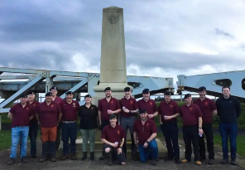
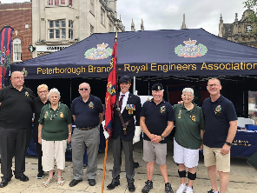
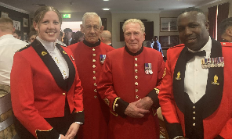
Unit & Branch Support Grants
18 Units & Branches assisted with a Unit & Branch Support Grant totalling £35,396.40:
Gazebos!
Battlefield Tour Grants
Espirit de Corps activities in Units
Sports Kits
Unit Awards (Defence Diving School)
Transport costs for branch events
Open Days (24 Cdo Engr Regt & 23 Para Engr Regt)
The REA supported more than 45 expeditions in 2022 (for Regular and Reserve soldiers):
Ultra-distance running
Skiing, Parachuting
Orienteering
Cycling
Caving
Climbing
Sailing,
Trekking.

Slide 19
ITEM #8
BENEVOLENCE REPORT

Slide 20
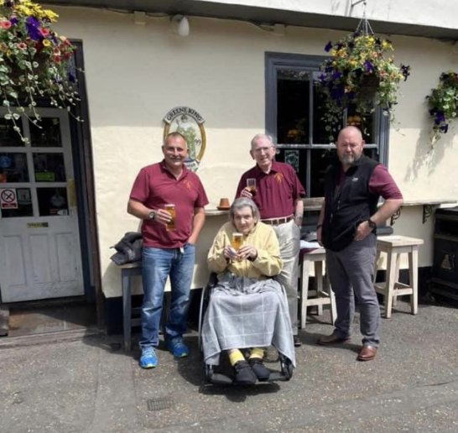
Benevolence
Benevolence Support – Available to Serving soldiers, dependent families, Veterans and dependents to overcome financial hardship The Benevolence Handbook explains this in detail through eligibility to how to apply – available on the REA
Kitchener Fund – Education funding for the children of Sapper families who are in extreme financial hardship following the death/injury/illness of a serving/veteran parent.
Gabriel Fund (REA Career recovery support) Education funding for veterans/service leavers who have to make a career change following a life changing injury/accident/illness.

Slide 21
Benevolence
MONTH | Grants Accepted | Grants Declined | Net Cost | Total Grants
June | 26 | 9 | 19,788 | 113, 214.02
July | 24 | 9 | 18,709 | 131,923.20
August | 41 | 12 | 32,629 | 164,552.20
Total | 91 | 30 | 71,126

Slide 22
Grant Accepted
ELECTRICAL REPAIRS NEW BOILER BUILDING WORK WHITE & BROWN GOODS FLOORING
BANKRUPTCY FEES GENERAL NEEDS FLIGHTS BABY GOODS VISA APPLICATIONS
EPV RISER/RECLINER GARDEN ADAPTATION RESPITE CARE PROFILING BED

Slide 23
Grant Declined
CAR REPAIRS NOT IN REMIT PRIVATE MEDICAL FEES NOT IN REMIT DRIVING LESSONS NOT IN REMIT 7 WEEKS SERVICE GOLF SUBS & LESSONS NOT IN REMIT MOTHER ISN’T A DEPENDANT
COULD PAY FOR ITEMS FROM SAVINGS, SO NOT IN POVERTY WA CONTINUATION DECLINED DUE TO CHANGE IN CIRCUMSTANCES

Slide 24
Example of Sp under £1000
Mr X lives is 59 years old, married and has 2 children. He lives with his son and wife on a house boat. His daughter is away at University and his son has just completed his a levels and hoping to go to university. Mr X is suffering with mental health problems, and has recently been discharged from Canterbury hospital where has admitted under Section 2 of the mental health act for assessment and treatment for Mania and Psychosis. Having reached the rank of Major Mr X has a healthy service pension but the majority of it is spent on mooring fees and rent. In total Mr X has a weekly deficit of £80. Mr X has been assisted by the REA in the past totally £1400 (Laptop & stove) and it is likely that this will not be the last request. This request was for benevolence was for assistance with debt clearance, household goods, clothes, gardening tools, laptop and coal totally £7234.32. The REA granted £1000 for the purchase of 1 x washing machine, clothing and coal. The case was also sent to the RBL for their consideration.

Slide 25
Thank you Letter(s)
“Firstly I would like to take this opportunity to pass on my greatest thanks to the REA for their firm support during my compassionate leave. Your assistance to repay for my airfare to Fiji to attend my late mother’s funeral is beyond explanation; in time when I really needed it. I cannot reiterate how emotionally it touches my family here in the UK of the help that REA gave me especially where mum was our last family member left back in Fiji. Everyone was very supportive including my line managers to our Welfare officer, Siobhan; you all have been exceptionally helpful.
There are some good things you can forget in life, but there are some that will be with you to cherish forever; and this is definitely one of them!
Thank you once again and may GOD bless you all.”

Slide 26
ITEM #9
AOB

Slide 27
Governance
Rule 4. 05 The Board
The affairs of the Association shall be directed by the Board of the Association.
It is the aim that the composition of the Board shall be such that it provides a diverse and representative group that provides the skills and experience to ensure the Association is able to fulfil its objects in the most effective manner:
President, a Colonel Commandant of the Corps nominated by the Chief Royal Engineer ratified by the Board appointment for maximum of six years.
Vice President of the Association nominated by the President and ratified by the board, maximum of 6 years over two three year terms. Will also Chair the Benevloence committee
The Corps Colonel for duration of appointment.
Honorary Treasurer elected by the board for maximum of 6 years over two three-year terms. Will also Chair the Finance Commitee
The Corps SM for duration of appointment.
Reservist – Nominated by President and ratified by vote of the Board maximum 6 years over two three year terms.
Serving officer – drawn from CO of RE Regts serving for a maximum of 2 times 3 year terms. Will also Chair the Recruitment Committee
Business Leader – a senior leader with connections to the Corps serving a maximum of 2 times 3 year terms
Senior Leader – a senior leader with a suitable background and connection to the Corps serving for a maximum of 2 times 3 year terms
Wider Community Trustee – externally recruited, position ratified by board for maximum six years over two three year terms
Governance Trustee – externally recruited, position ratified by the board for a maximum of six years over two three year terms
Service Charity Trustee - externally recruited, position ratified by the board for a maximum of six years over two three year terms.
As Chair of the management committee and secretary to the Board the CEO will represent the views of the wider Association to the Board

Slide 28
DATE OF NEXT AGM
SATURDAY 14TH SEPTEMBER
BROMPTON BARRACKS
(Corps Memorial Weekend)

